Slide 1
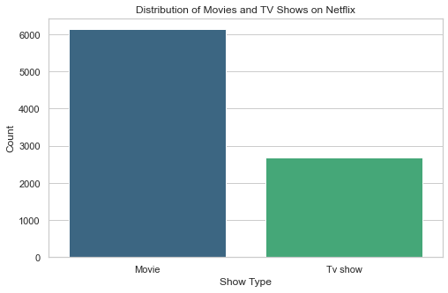
DISTRIBUTION OF MOVIES AND TV SHOWS ON NETFLIX

Slide 2
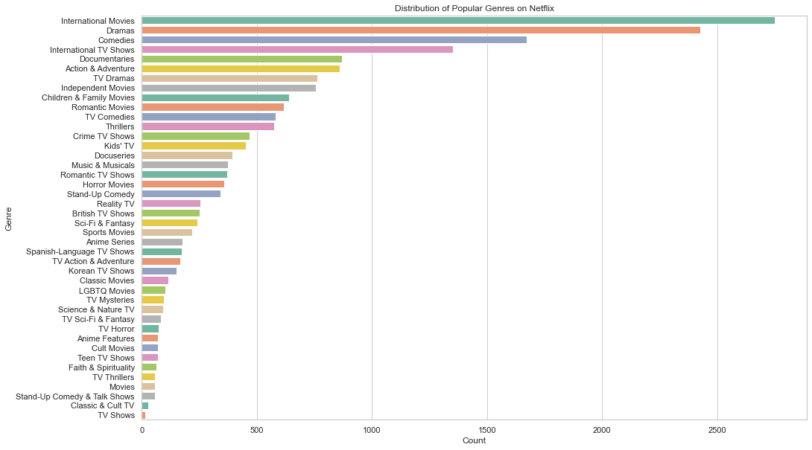
SHOWCASING THE POPULAR GENRES ON NETFLIX

Slide 3
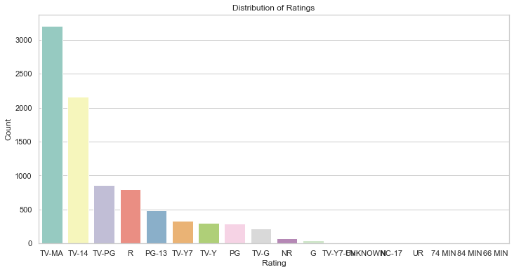
RATINGS ACROSS TV SHOWS AND MOVIES ON NETFLIX

Slide 4
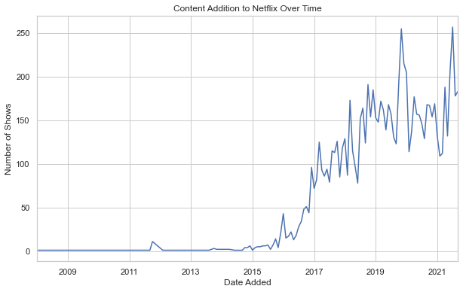
CONTENT ADDITION TO NETFLIX OVERTIME

